Slide 2
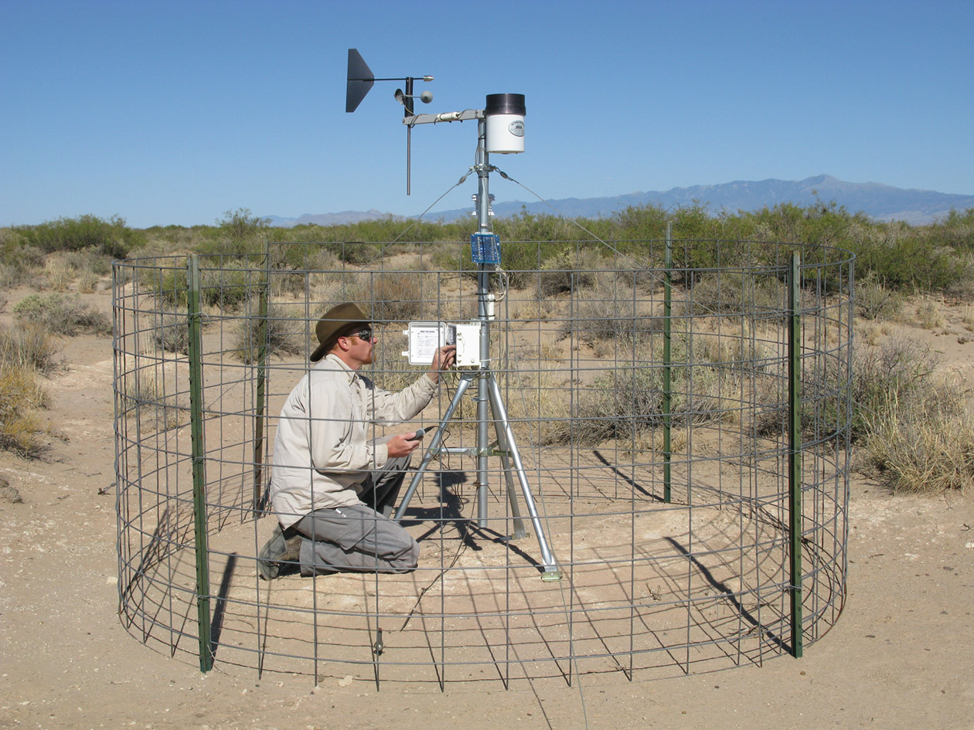
Scientists collect vast amounts of data.
What can we do with it?
Photo source: jornada.nmsu.edu/monit-assess/data-collection/automated
Notes:
Scientists around the world are collecting vast amounts of data every day. However, the general public often learns very little, if anything, about the information that scientists have amassed. There is a gap in the communication of scientific information to nonscientists.

Slide 3
Water Conservation Data Jam
Goals:
Design a creative project that explains water use data to an audience not familiar with this information.
Develop a water conservation action plan.
Notes:
Students will be creating a Climate Data Jam project over the next two days. The goal is to design a creative project and presentation that explains local precipitation and temperature data to an audience not familiar with this information.

Slide 4
Inspiration: Infographic
In the 2006 season, MLB players ran a total of 1,245 miles around bases (73,080 bases x 90 feet between bases).
Craig Robinson
www.flipflopflyball.com
Notes:
Here is an example of an effective way to communicate data. This infographic is interesting and easy to understand because it puts data into a context to which most people in the continental United States can relate. Simply stating that MLB players ran a total of 1,245 miles in 2006 may be considered by some to be a dry statistic. However, scaling a baseball diamond to represent 1,245 miles and overlaying it on a map of the continental United States may help people understand how large the distance is and inspire them to take an interest in the statistic.

Slide 5
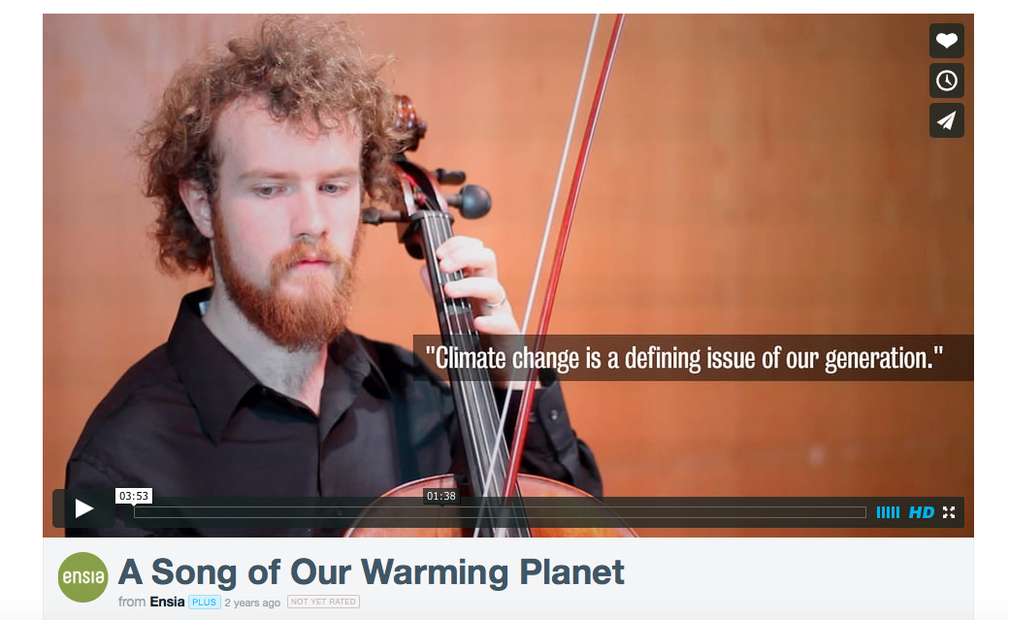
Inspiration: Music & Video
A Song of Our Warming Planet
http://vimeo.com/m/69122809
Notes:
This is an example of using music to communicate data. A University of Minnesota student, Daniel Crawford, created a song to represent the increase in average global temperatures since 1880. He was looking for a method to communicate scientific data in a way that would be more appealing to nonscientists and “people who would get more out of [a song] than maps, graphs, and numbers.”

Slide 6
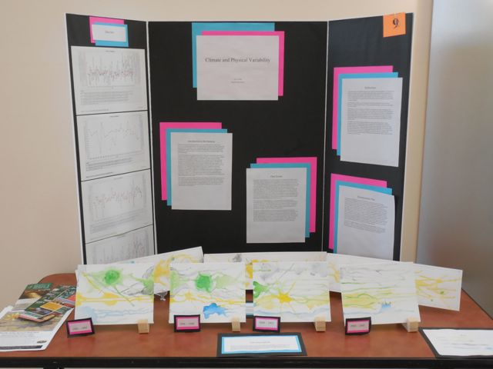
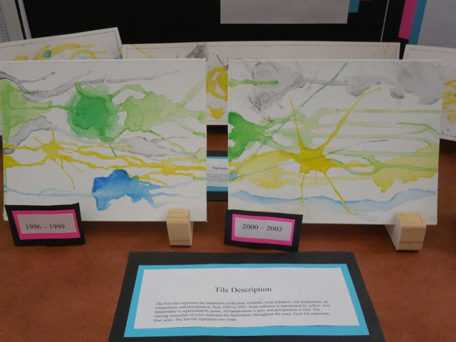
Inspiration: Painting
Notes:
Here is an example of a student using painting to communicate data. The different colored paint splatters were scaled to reflect the amounts of solar radiation, soil temperature, air temperature, and precipitation over several 4-year periods in Las Cruces, New Mexico.

Slide 7
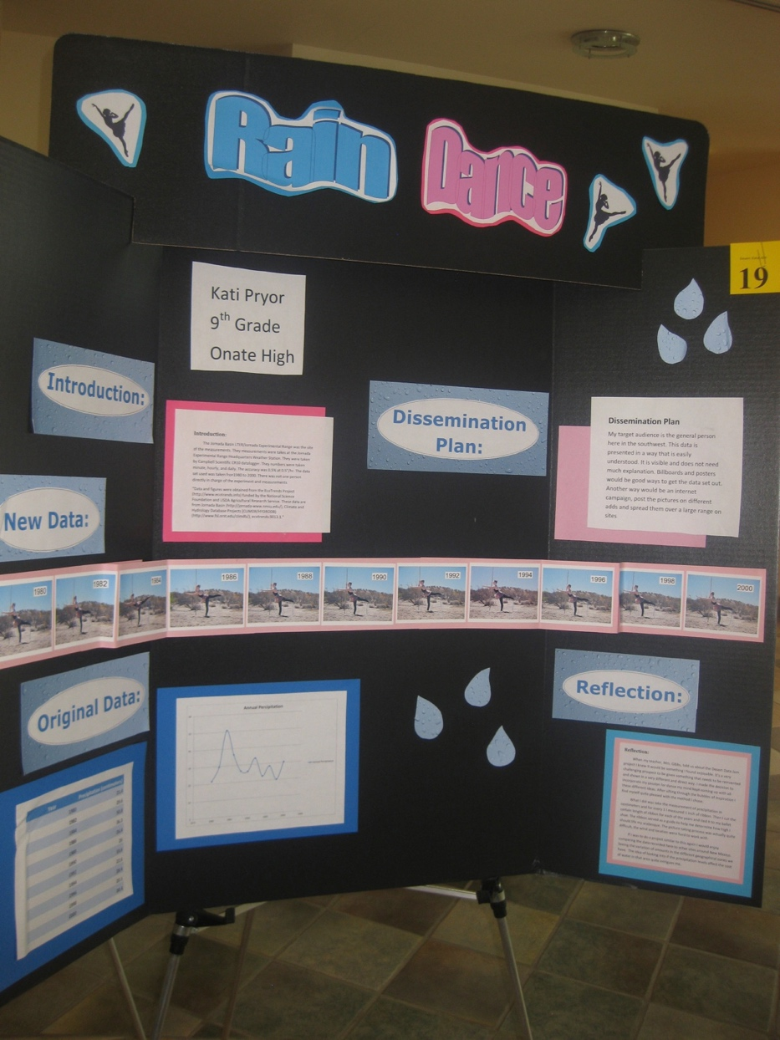
Inspiration: Dance
Notes:
This is an example of a student using dance to communicate data. The height of the student’s foot was scaled to represent the amount of precipitation received each year in Las Cruces, New Mexico. The ribbon tied to her foot helps visualize the differences each year.

Slide 8
Water Conservation Data Jam
Teams of 1-3 students
Creative, non-traditional product (e.g., song, demonstration, poem, children’s story, newscast, etc.)
Must be scaled to represent a trend or trends in the data accurately
MAY also examine implications of data, but MUST include data trend

Slide 9
A Good Data Jam Project is:
Clear: Represent the data accurately and in a way that is understandable to non-scientists.
Include a legend
Creative: Use your imagination!
Concise: Focus on one important trend in the data.

Slide 10
Timeline
Introduction to the project, start examining data
Identify trends and create project
Present creative project to class
Create action plan to address water use issues

Slide 11
Understanding our Units
Volume:
Length x Width x Height
? Mega Gallons
Your Classroom
1 gallon
Height
Milk
Width
Length

Slide 12
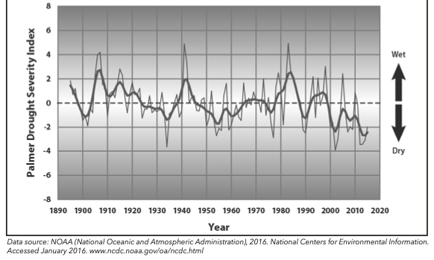
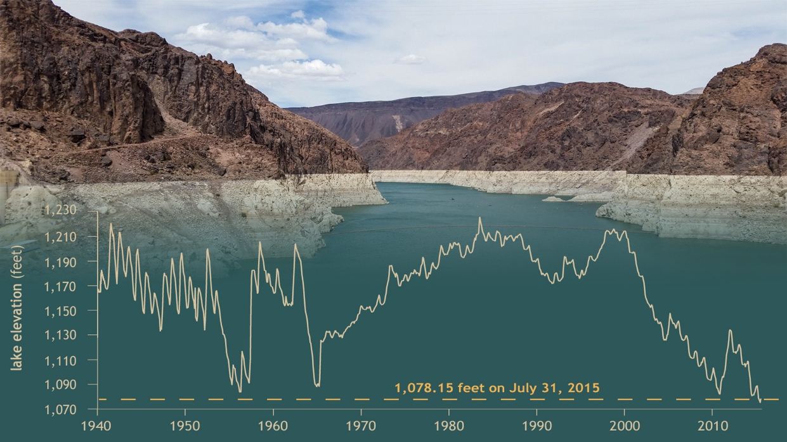
Data Trend Examples:
Drought Severity in the Southwestern United States, 1985 - 2015
Since 1895, drought severity in the
Southwestern U.S. has _________ .
increased or
decreased?
Water levels in Lake Mead, NV
From 2000 to the present,
water levels in Lake Mead have ___________ .
increased or
decreased?

Slide 13
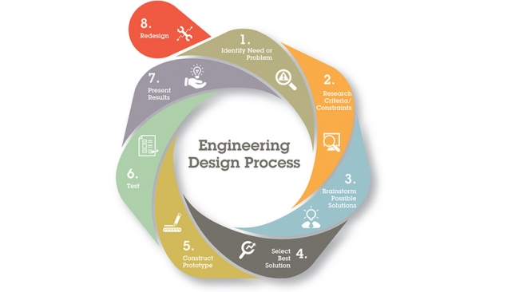
Action Project
Stage 5: Evaluate progress and identify ways to improve project
Stage 1: Identify the problem and the constraints
Stage 4: Execute the project
Stage 2: Brainstorm and select the best solution
Stage 3: Plan the prototype project

Slide 14
Stage 1: Identify the Problem and the Constraints
Problem: The southwest is expected to experience severe droughts due to climate change and the increasing population requires water.
Constraints: Determined by the teacher:
Time to complete project
Notes:
Have students write the problem they are trying to solve on #1 of their Engineering Project Planning Guide.
Students should also think about what constraints will be in place as they move forward. The educator will set the project constraints, which can be broad or specific. They should include details such as group size, amount of money available for the projects, locations, deadlines, etc. Have students write these constraints on #2 of the Engineering Project Planning Guide.

Slide 15
Stage 2: Brainstorm and Select the Best Solution
Remember that your project should attempt a solution for the identified problem.
Keep in mind all the constraints.
Work with your group to come up with the best solution possible.
Example Solution:
Collect rain water to use for watering outdoor plants, and cleaning outdoor spaces.
Notes:
If your students choose their projects, remind them to make sure their projects solve the problem we identified and work within the framework of the constraints you outlined.

Slide 16
Stage 3: Plan the Prototype Project
Tasks | Who Will Be in Charge of this Task? | Deadline
Research and determine the best rainwater harvesting system. | LG | June 30, 2020
Write a proposal that includes the design idea, costs, and proposed location for the rainwater harvesting system. | LG | July 20, 2020
Present proposal at next Board of Directors meeting. | SB | July 20, 2020
Secure funding for the project. | SB | July 31, 2020
Purchase all materials. | LG | October 15, 2020
Install rainwater harvesting system. | JV | November 1, 2020
Create an informational poster about the rainwater harvesting system. | LG | December 31, 202o
Notes:
We encourage students to plan before executing their projects. Detailed planning may be unfamiliar to many students. Here are some considerations for guiding your students through project planning:
1. Have students make a list of every task that needs to be completed. If each task has a specific deadline, it can keep the project moving forward.
2. It may be worthwhile to require students to submit a plan and have it approved before executing their project.
3. Encourage students to assign specific group members to tasks. This way, everybody has a role in making the project a success.
4. Remind students that plans change, and while they will likely be adding and removing things from their plan as challenges arise, it is vital to start with a framework for how they will achieve their goal of solving the problem identified in Stage 1.

Slide 17
Stage 4: Execute the project
Carry out your project plan.
Be flexible and adaptable.
Communicate as a team!
Notes:
Once students have planned their project, they are ready to execute. Here are some things to consider when supporting your students in project execution:
1. Encourage communication within groups. Communication could be daily or weekly check-ins regarding the status of their project. If students are in sub-groups, each sub-group needs to report to the whole group on their tasks. Bigger groups require more intentional communication.
2. Remind students that as they execute their project, their plans may change, which is a normal part of project planning.
3. Encourage students to keep their problem and proposed solution in mind and constantly evaluate if they are on track to meet their end goal.

Slide 18
Stage 5: Evaluate progress and
identify ways to improve project
During the project, reflect on what is going well (#6) and what needs to be improved (#7).
At the end of the project, evaluate your team’s accomplishments (#8):
A. Did your project help solve the problem?
B. What would you do differently if you were starting the project again?
Notes:
Let students know that they should constantly evaluate their project and look for ways to improve it. This step is a critical component of engineering design. The Engineering Project Planning Guide instructs students to reflect on successes (#7) and challenges (#8) at least once during the project period, but you should encourage students to constantly improve their projects as they execute them.
At the end of the project, students should evaluate their project’s success in solving the problem they identified in Stage 1. They should provide evidence to support their claim. Finally, students should reflect on changes they would make if they were starting their project again.

