Slide 1
Wildfire and Climate Change
Playing with Fire

Slide 2
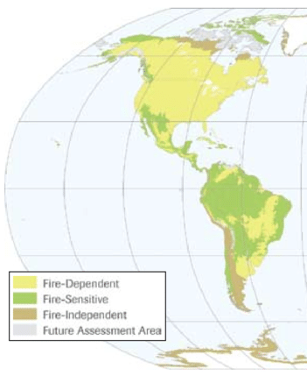
Fire-dependent Ecosystems
What type of ecosystem do you live in?
Source: https://www.researchgate.net/figure/Global-distribution-of-fire-dependent-fire-sensitive-and-fire-independent-ecosystems_fig1_43283707
Notes:
Many ecosystems depend on fire. This map shows the results of a study that mapped fire-dependent ecosystems. You can see that a large portion of ecosystems in North America are fire-dependent, which means that low-intensity fires are fundamental to the survival of some plants and provide critical habitat for animals. These ecosystems have evolved to bounce back following a fire event. Ask students to describe the type of ecosystem they live in, and notice where they live on the map. Is the area where they live affected by fire?

Slide 3
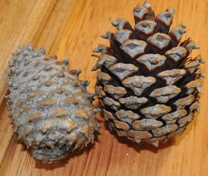
Serotinous Cones
After fire
Before fire
Table Mountain pine (Pinus pungens)
Source: https://www.nps.gov/grsm/learn/nature/dff8-agestruc.htm
Notes:
Some types of trees require fire for reproduction. They have cones that only open to release seeds if they are heated enough to melt the resin coating the outside. These are called serotinous cones.

Slide 4
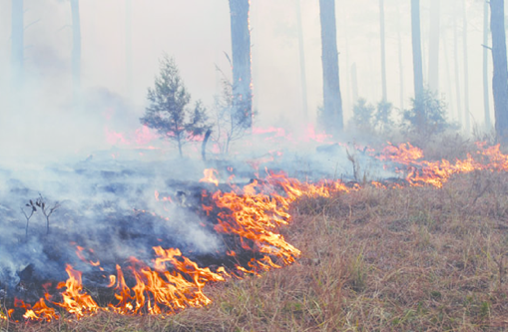
Clearing Understory Plants
Make space for tree growth by clearing understory plants
Why talk about wildfire and forest ecosystems?
Source: https://www.researchgate.net/figure/Prescribed-low-severity-surface-fire-carried-by-needles-cones-dried-grass-and-forbs_fig1_286661962
Notes:
Wildfires can also clear accumulated leaf litter and small understory plants, creating space that certain tree species need to grow. Today we are focusing on forest ecosystems because they have the most damaging wildfires. When a tree burns, carbon is released into the atmosphere, contributing to climate change. Even if you don’t live in a place with forests, wildfires in forests still impact you.

Slide 5
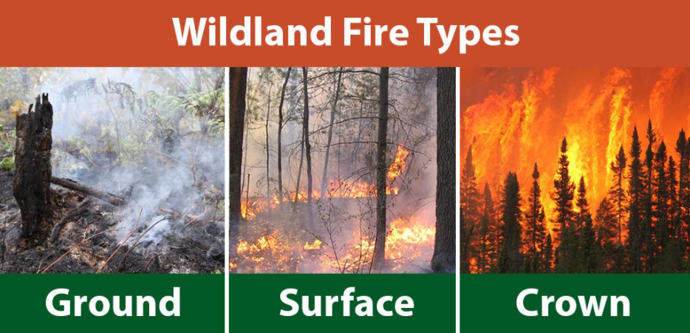
Source: Ontario’s Ministry of Natural Resources and Forestry
https://twitter.com/ONforestfires/status/1102634466831409153/photo/1
Notes:
There are three main types of wildfires. Ground fires burn accumulated dead vegetation below the surface of the ground. Surface fires burn leaf litter and smaller understory plants. Crown fires burn entire trees up to the tops. Which type of fire looks like it would do the best job of clearing the understory to allow for new tree growth? [Answer: surface or ground fire]. Which of these photos looks like a more destructive fire, like the ones you see on the news? [Answer: crown fire].

Slide 6
Building a Model
Notes:
Tell students that we will use a model to learn more about these different types of fires and how our current fire regime in forests came to be.

Slide 7
Now What?
History of fire suppression
Climate change
More frequent, severe, and destructive fires
Notes:
Humans can mitigate (or reduce) the effects of climate change, but we also need to adapt to life in a changing climate. Optional extension: Write “History of fire suppression,” “Climate change,” and “More frequent, severe, and destructive fires” on the board or on posters around the room. Give each group a stack of post-it notes, and have them brainstorm solutions for each of these three problems.

Slide 8
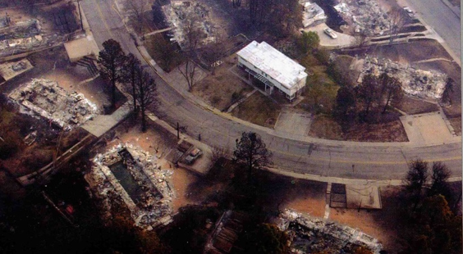
May 2000, Cerro Grande Fire Los Alamos, NM
Source: Los Alamos Amateur Radio Club
http://laarc.weebly.com/archive.html
Notes:
In May 2000, the Cerro Grande fire ignited in Los Alamos, NM. It burned 261 houses and caused millions of dollars in damage. What do you notice about this photo? [Answer: Every house except one burned]. Why do you think that house survived?

Slide 9
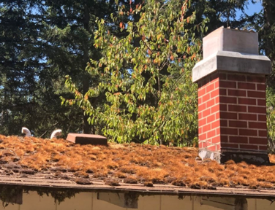
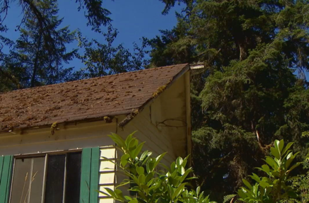
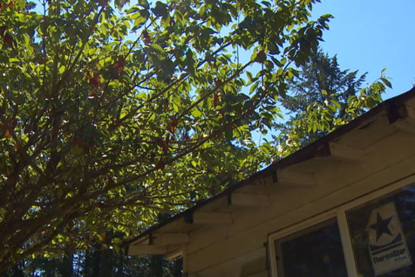
Defensible Space
Source: KOMO News Seattle
https://komonews.com/news/local/firefighters-good-defensible-space-can-help-protect-your-home-during-wildfire
Notes:
One example of something people can do to adapt to the effects of more severe wildfires is to create defensible space – an area around buildings and homes that is easy to protect from fire. What fire hazards do you notice in these photos? [Answer: pine needles on roof, trees close to building could increase damage from the fire]. To minimize the risk of fire damaging buildings, these should be removed.

Slide 10
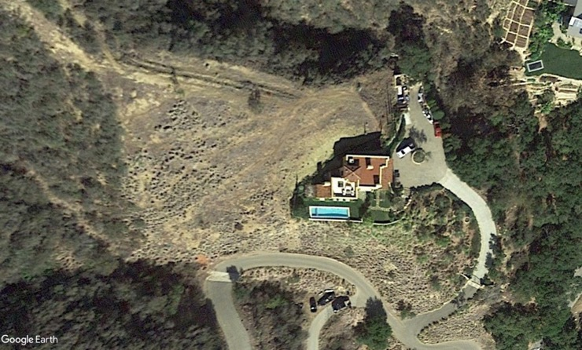
Defensible Space
Source: Los Padres Forest Watch
https://lpfw.org/fire/defensible-space/
Notes:
This is an example of a building with defensible space. You can see that a large amount of vegetation surrounding the house has been removed. Even though we can’t see it, it’s also likely that combustible materials (like pine needles on the roof, wooden lawn furniture) have been removed from outside and on the house. If we can remove flammable things near buildings, can we also do that in the forest?

Slide 11
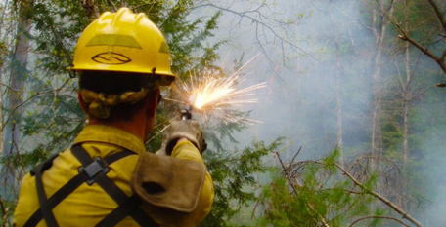
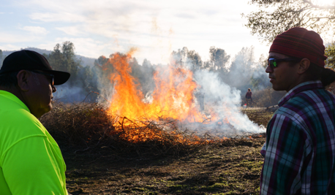
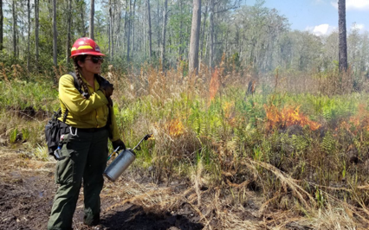
Prescribed Burns
Source: NPS
https://www.nps.gov/articles/what-is-a-prescribed-fire.htm
Source: NPR
https://www.npr.org/2020/08/24/899422710/to-manage-wildfire-california-looks-to-what-tribes-have-known-all-along
Source: Eric Aldrich/TNC
https://www.nature.org/en-us/about-us/where-we-work/united-states/florida/stories-in-florida/all-women-controlled-burn/
Notes:
When fire risk is low, firefighters conduct prescribed burns to clear areas of vegetation that can lead to crown fires. The top left photo shows a wildland firefighter igniting a prescribed fire using a flare gun, and the bottom photo shows a drip torch. Native tribes like the North Fork Mono in California have been doing this for centuries – called cultural burning, for ceremonial and land management purposes.

Slide 12
Playing With Fire Game
Notes:
Now, you will use what you know about wildfire to play a game in small groups. Show the video to explain how to play the game.

Slide 13
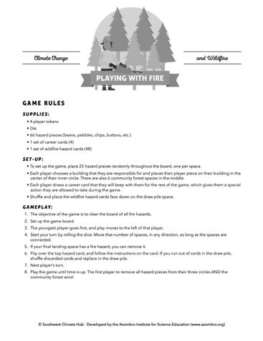
Playing With Fire Game
Play the game until time is up
After the game: Design a community that is protected from wildfire
Notes:
After playing the game, you will design your own community that’s protected from wildfire based on what you learn, so keep that in mind. Gameplay may last 8-20 minutes; if students finish early, they can play again or start on their poster. See the handout for a reminder of the game rules.

Slide 14
Design a Community
Use your poster to design a community that is protected from wildfire
Write or draw
Include and explain at least 5 strategies that you included to mitigate the effects of wildfire
Example: Wildland firefighters conduct a prescribed burn on the forest to reduce future fire risk.
Notes:
As students finish playing the game, pass out a poster to each group. Tell students that their goal is to design a community that is protected from wildfire. Students can write or draw, but they must describe or label at least five examples of strategies they included to adapt to the effects of wildfire. Tell students that as a starting point, they can select one of the cards they used in the game and see if it describes a strategy they could use. For example, if they have a card that mentions prescribed burning, they could draw firefighters in the forest near their community. The slide shows this example of what they should include on their poster.

Slide 15
Conclusion
What is causing the increase in wildfires?
How will land and fire management change in the future?
Source: Westerling et al. 2006, Warming and Earlier Spring Increase Western U.S. Forest Wildfire Activity. Science
Notes:
This graph shows the increase in temperature and number of wildfires from 1970 to 2005. What is causing the increase in the number of wildfires? [Answer: temperatures increase from climate change, leading to more tree mortality. A history of fire suppression led to increased fuels in forests, leading to more frequent and severe fires.] How will land and fire management evolve in the future? What can we do about these problems? [Possible answers could include: reduce our greenhouse gas emissions to reduce climate change, allocate more funding to land management, change policies to allow for more prescribed burning, educate people about creating defensible space around buildings, etc.] How would fire management look different in your community, based on the ecosystem you live in (i.e., desert, grassland, city)?

