Slide 2
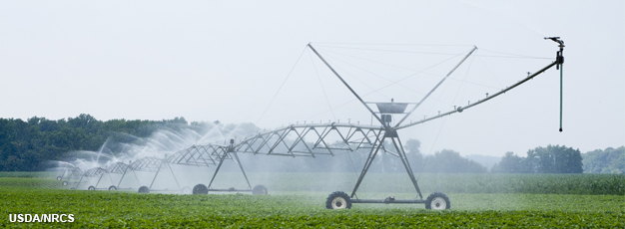
Crops & Water
Source: http://www.ers.usda.gov/amber-waves/2013-september/western-irrigated-agriculture-production-value,-water-use,-costs,-and-technology-vary-by-farm-size.aspx#.Vya2amM2et8
Notes:
-As you probably know, crops need to be watered.
-Today, we are going to examine what happens to the water that plants take up.

Slide 3
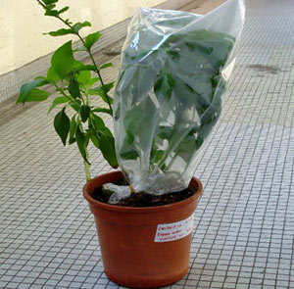
Transpiration
Loss of water from inside plants into atmosphere
  Cools plant
  Enables flow of water and nutrients from soil
Source: water.usgs.gov/edu/watercycletranspiration.html
Notes:
-One of the things that happens to the water that plants take up is a process called transpiration.
-It is the loss of water from inside plants into the atmosphere.
-It functions to cool the plant.
-Also, it helps to drive water movement through the plant and bring water and nutrients up through the roots and into the stems and leaves.
-It’s basically an invisible process, but if you cover the leaves of a plant with a bag, the bag will get foggy with the water that is being transpired.

Slide 4
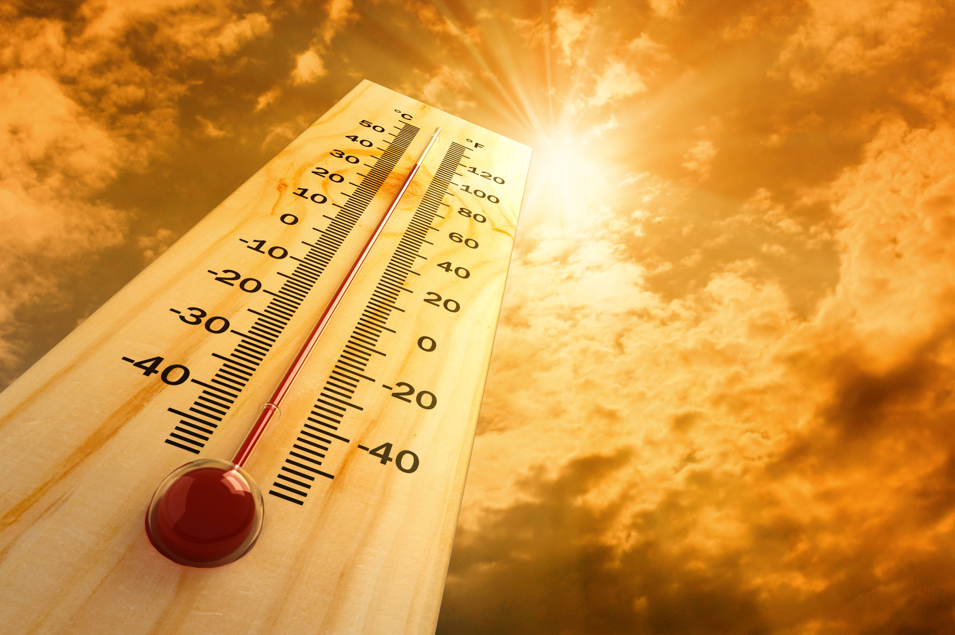
Transpiration
Some factors that affect transpiration
  Temperature
  Light
  Relative humidity
  Wind
  Carbon dioxide
  Soil moisture
Source: farmersalmanac.com/weather/2010/11/22/how-does-a-thermometer-work/
Notes:
-Transpiration does not always happen at the same rate.
-Environmental variables affect transpiration rates, and here are some of the factors that can slow down or speed up transpiration: temperature, light, relative humidity, wind, carbon dioxide, and soil moisture.

Slide 5
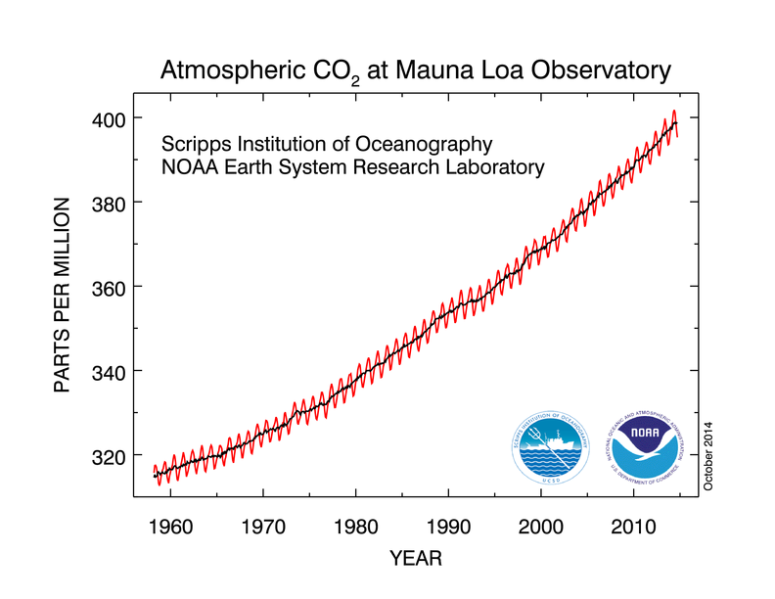
CO₂ in the Atmosphere
Source: www.esrl.noaa.gov/gmd/ccgg/trends/
Notes:
-Let’s think for a moment about the climate currently and how it is changing.
-Since 1958, scientists at Mauna Loa, on a Hawaiian island in the North Pacific, have been collecting atmospheric data. This graph shows the concentration of carbon dioxide in the atmosphere as measured at Mauna Loa.
- Ask students to describe the trend of this graph [answer: carbon dioxide is increasing; some students may also notice that there is a sawtooth pattern from seasonal CO₂ uptake and release in the northern hemisphere].

Slide 6
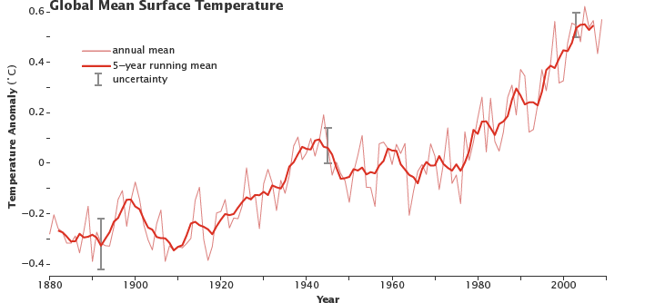
Global Temperature Change
Recorded Data Since 1880
Source: earthobservatory.nasa.gov/Features/GlobalWarming/page2.phpv
Notes:
We have recorded data on Earth temperatures since 1880. Ask students to describe the trend of this graph [answer: temperature is increasing].

Slide 7
Transpiration
Some factors that affect transpiration
  Temperature
  Light
  Relative humidity
  Wind
  Carbon dioxide
  Soil moisture
Source: farmersalmanac.com/weather/2010/11/22/how-does-a-thermometer-work/
Notes:
-Remember the factors that affect transpiration.
-We just mentioned that the concentration of carbon dioxide in the atmosphere is increasing.
-With this increase, we are also seeing an increase in temperature.
-We will focus on these two factors in our activities today.
-First, we will investigate the effects of temperature on plant transpiration.
-We are going to conduct an experiment that will serve as a model for crops in a warming climate and a way to examine a possible adaptation.

Slide 8
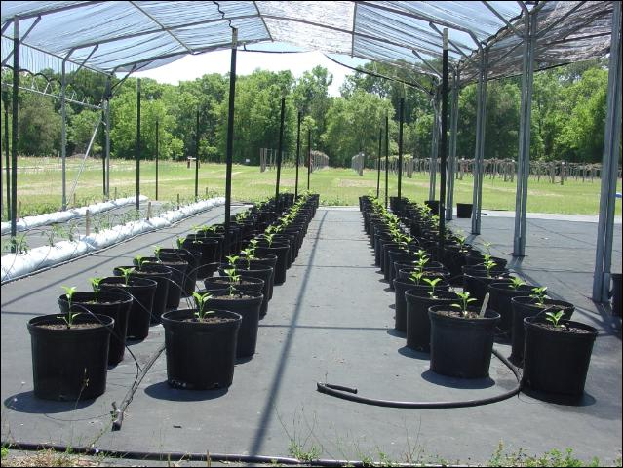
Shade as Adaptation to Heat
Used experimentally in:
  Bell peppers
  Tomatoes
  Cherries
Decreased
temperature
Increased yield
Source: edis.ifas.ufl.edu/hs368
Notes:
-Farmers in many areas will need to strategize about how they will adapt to increasing temperatures.
-Some may shift the seasons in which they grow certain crops.
-Some may switch to more heat-resistant varieties of crops.
-Another adaptation that is being used experimentally is shade.
-It has been used with bell peppers, tomatoes, and cherries.
-The shade helps to reduce the temperature underneath.
-Producers have experienced increased yields in these crops with the use of shade structures.

Slide 9
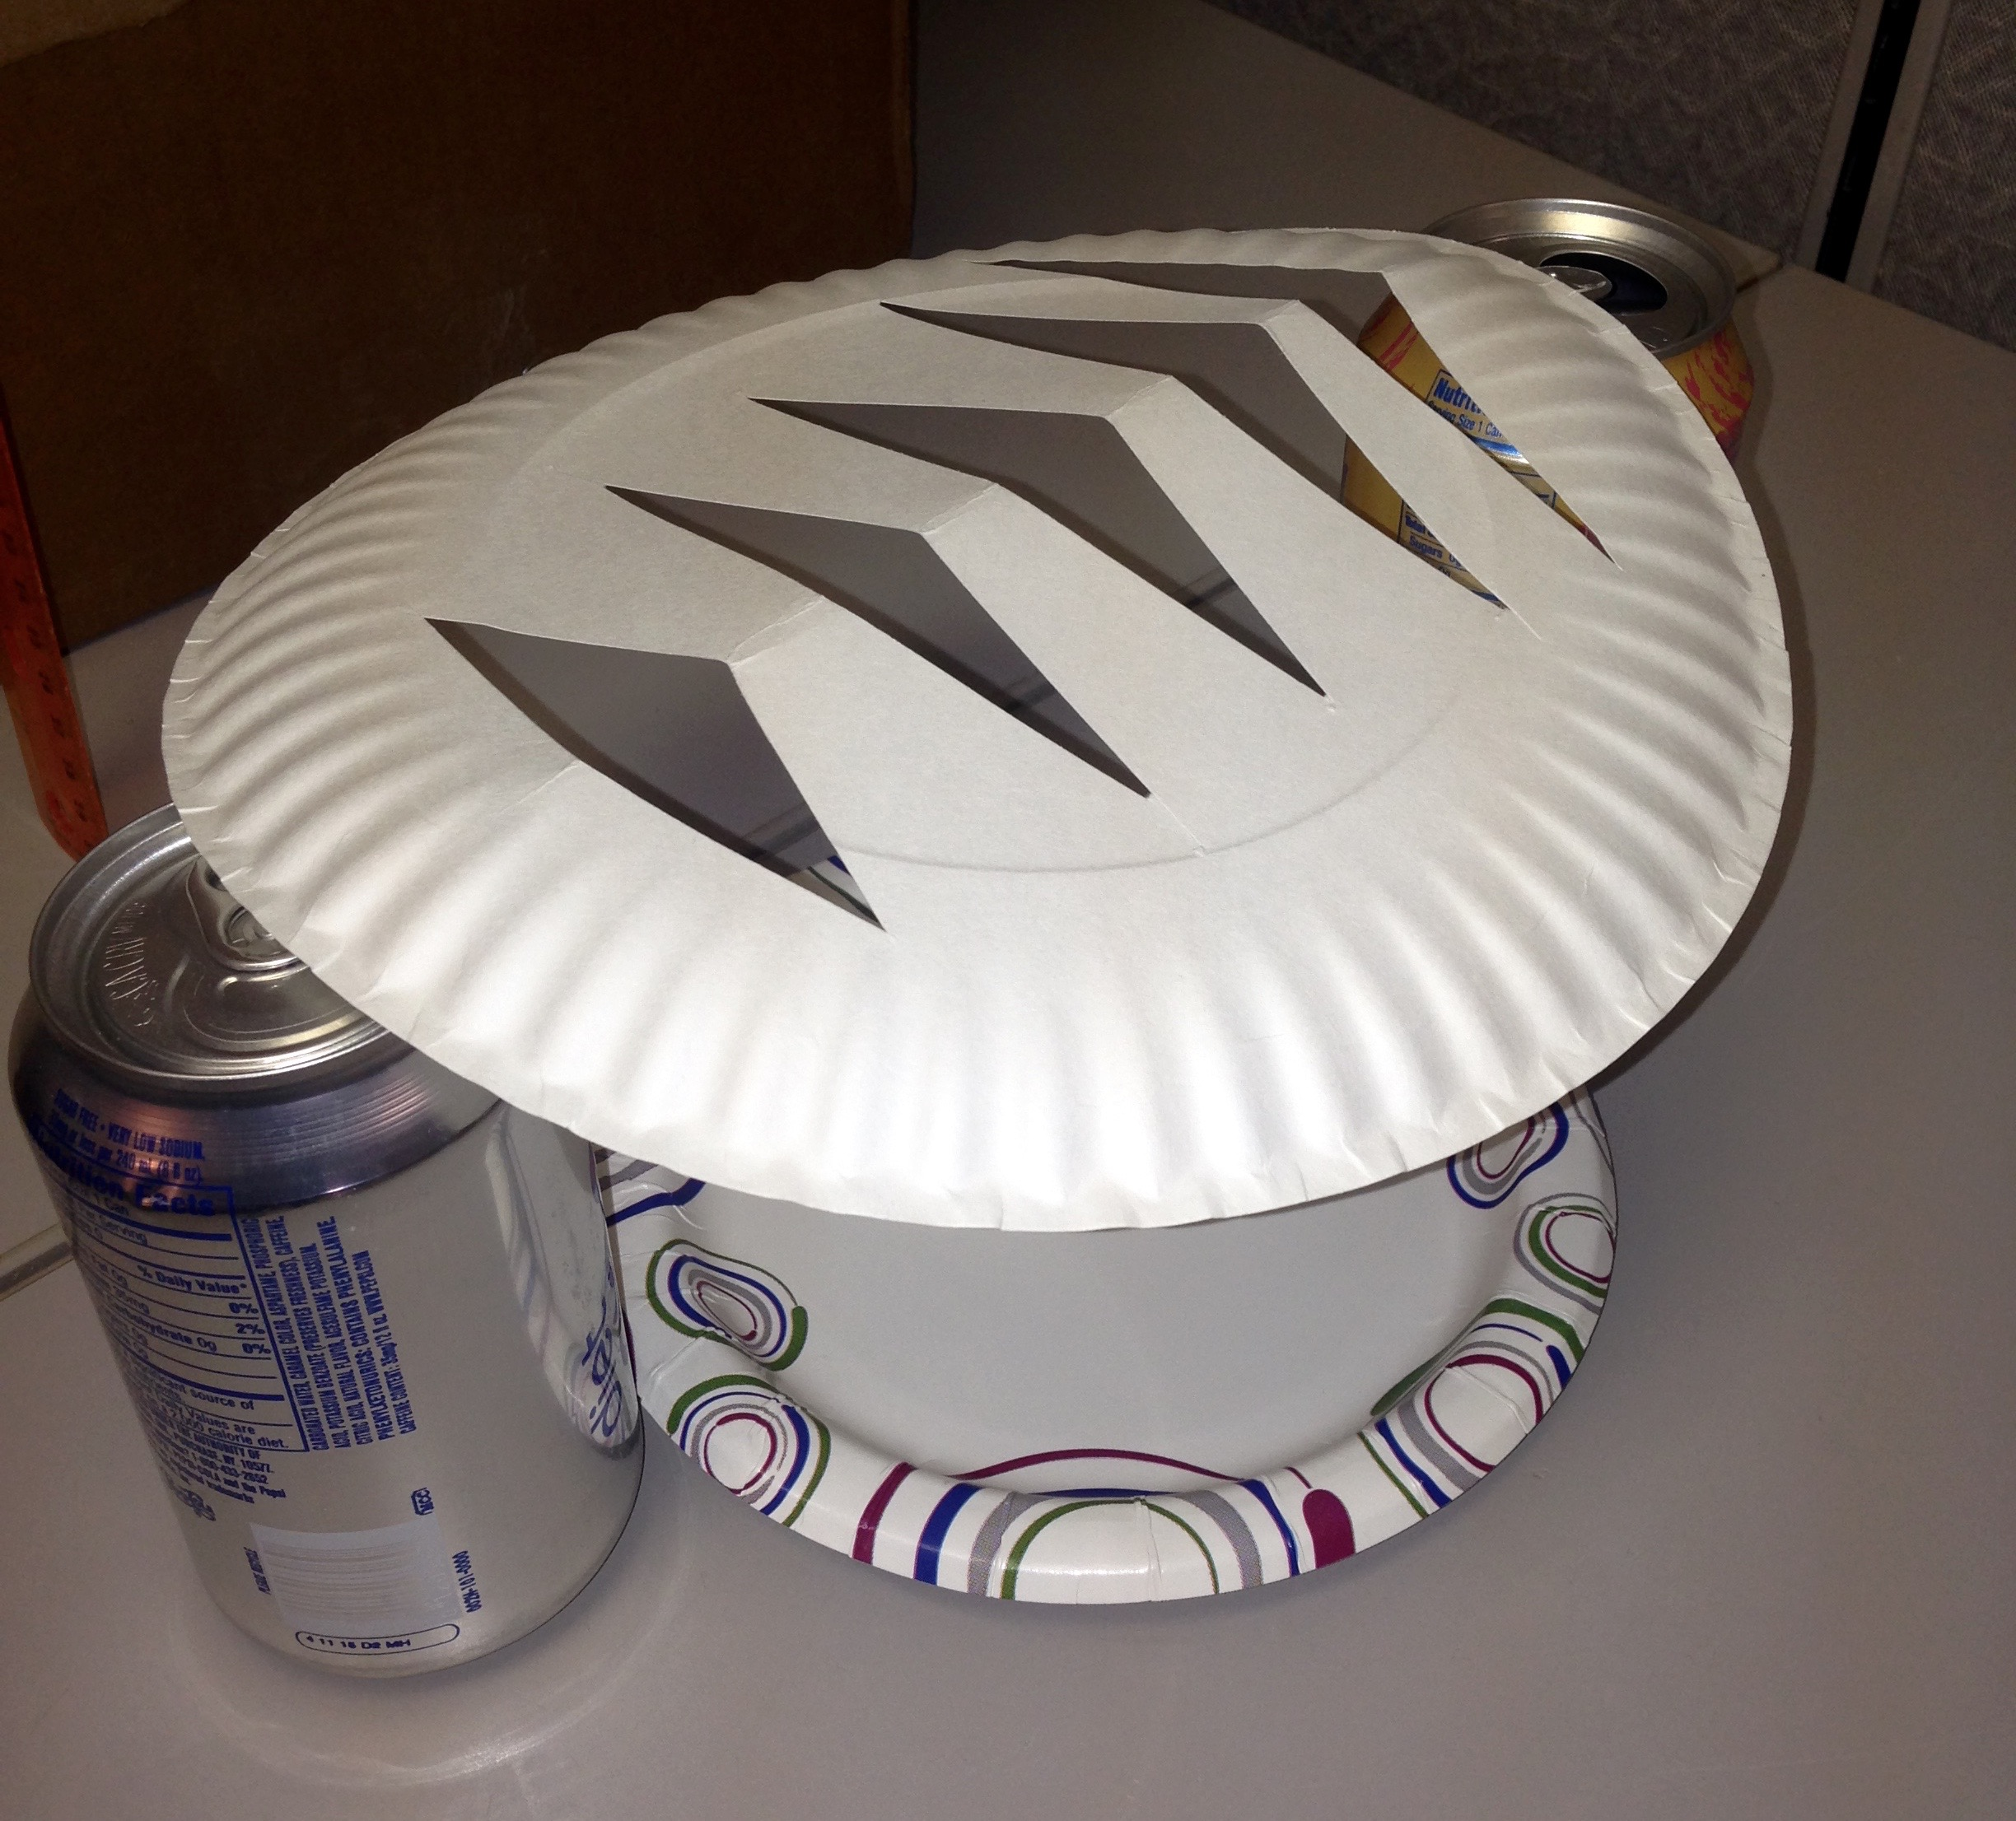
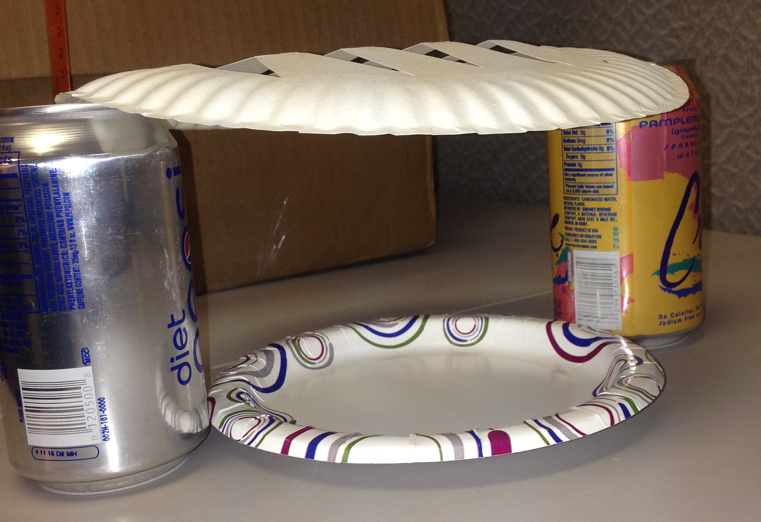
Setting Up the Experiment
Notes:
-We are going to conduct an experiment that uses a shade structure model made out of a paper plate with holes cut out of it that is resting on two soda cans.
-We will be comparing the water loss from two bunches of spinach placed under lights for 30 minutes. One will be placed under a paper-plate shade structure, and one will be left out in the open under the light.
-Instruct students to make a prediction about which treatment will result in higher water loss and then fill in the blank of the prediction statement on page 1 of the handout.

Slide 10
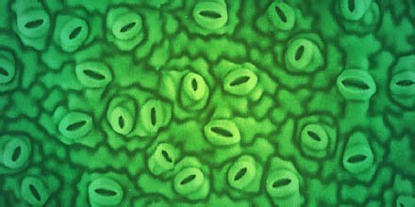
Transpiration: how does water escape?
Stomata
  Singular: stoma
Pores on plant structures
  Usually microscopic
  Open and close
Carbon dioxide enters
Water & oxygen escape
Source: biology.anu.edu.au/research/projects/electrophysiology-and-molecular-studies-stomata-during-drought
Notes:
-Plants have pores on their structures called stomata that allow them to exchange gases with the atmosphere.
-They are usually microscopic.
-They open and close in response to the environment.
-When a stoma is open, carbon dioxide needed for photosynthesis enters, and water and oxygen escape.

Slide 11
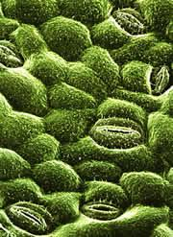
Climate Change & Stomata
Carbon dioxide
  Increasing
  Stomata: closed
    Plant takes in CO₂ more quickly
Temperature
  Increasing
  Stomata: open
    Warmer air increases driving of water out of stomata
Source: www.nature.com/news/2004/040121/full/news040119-5.html
Notes:
-Now let’s think about climate change and how it is affecting transpiration.
-As we saw earlier, carbon dioxide is increasing in the atmosphere.
-When carbon dioxide is abundant, stomata tend to close because the plant is able to take in carbon dioxide quickly, and the plant gets as much as it needs.
-When the stomata are closed, the plant does not lose water to the atmosphere. This can be good for farmers because less water is needed when stomata are closed.
-However, the global average temperature is also increasing.
-In warmer temperatures, stomata are usually open because warmer air tends to drive water out of the stomata.
-This is usually the case if plants have sufficient water and are not under water stress.

Slide 12
Don’t Be a Loser!
Reality
  Climate change
    CO₂, temp
Science fiction
  Miniature farmer
For 9 days, every day at 12:00 pm
  Visit same stoma
  Open or closed?
  Relative temperature
Source: biology.anu.edu.au/research/projects/electrophysiology-and-molecular-studies-stomata-during-drought
Notes:
-We are going to play a game to examine the effects of climate change on water loss through transpiration called Don’t Be a Loser!
-Our game will be dealing with the reality of our changing climate, in which carbon dioxide and temperatures are increasing.
-We will also include some science fiction. Imagine that you are a farmer with the ability to miniaturize.
-For 9 days, every day at 12:00 pm you will miniaturize and visit the same stoma on the same tomato plant.
-You will observe whether the stoma is open or closed. You assume that the stoma that you observe is giving you a reasonably good idea about how the rest of the stomata on the plant are behaving.
-You will also consider the temperature at that time each day relative to the historic temperature average of the previous 30 years.

Slide 13
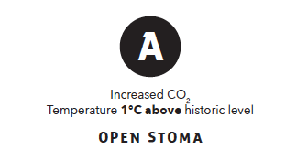
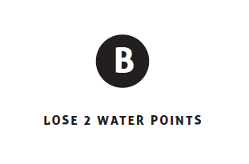
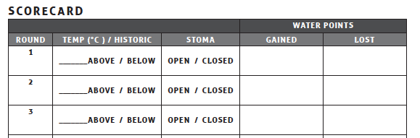
Don’t Be a Loser!
1
2
Notes:
-You and your partner will be given a stack of nine cards, and each card represents what you see on your daily 12:00 pm visit to the stoma on your tomato plant.
-You will begin by looking at the A side of your first card.
-You will fill in the conditions noted on the card on your scorecard on page 6 of your handout.
-We will use this example to look at how to fill in the scorecard. Just follow along with me; do not write anything on your handout yet.
-Carbon dioxide is at an increased level on this card, which is how it will be on every card over the course of the game.
-We see that the temperature is 1 degree C above historic level, so, on our scorecard, we will write one in the blank for temperature [click mouse or use enter key to advance slide for animation] and circle “above” [click mouse or use enter key to advance slide for animation].
-Because it is warm, the stoma is open, and the card reads “open stoma.” We will circle “open” in the stoma column on our scorecard. [Click mouse or use enter key to advance slide for animation.]
-Now we will flip our card over to the B side.
-It says that we will lose two water points because our stoma is open. We will write “2” in the lost column in the water points section of our scorecard. [Click mouse or use enter key to advance slide for animation.]
-If we were playing, we would then go on to our next card.
-You will now receive a stack of cards, and you will record the conditions from the A side and water points from the B side of each card over nine rounds.
-Note that we are using degrees Celsius (°C) in this activity since this is how scientists measure temperature. A change in the temperature in °C is equivalent to a larger number when measured in Fahrenheit (°F). Let us imagine, for example, that it is a warm summer day in the Southwest, and it is 35°C, which is 95°F. If the temperature were to increase by 2°C, or to 37°C, it would equal 98.6°F. To convert temperatures in Celsius to temperatures in Fahrenheit, we multiply by 1.8 and add 32.

Slide 14
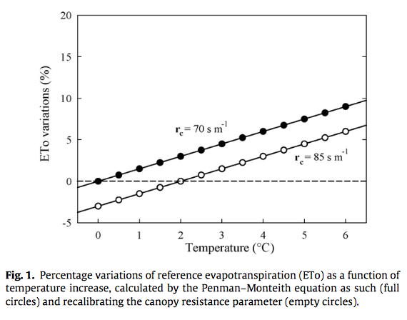
Climate Change & Stomata
What does research tell us?
  When temp increases, crop transpiration increases
Source, Lovelli et al. 2010: www.sciencedirect.com/science/article/pii/S0378377410001022
Notes:
-In the game, you saw that the amount of water transpired increased as the temperature increased.
-For example, you can see on your scorecard that when the temperature was 1 degree C above historic temperature, the plant lost 2 water points, and when the temperature was 2.5 degrees C above historic temperature, the plant lost 7 water points.
-This is what research demonstrates as well.
-This graph is from a research paper that shows that when temperature increases, crop transpiration also increases. The two lines show two different equations used to calculate transpiration, and they both show an increased rate with increased temperature.

Slide 15
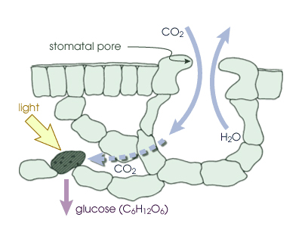
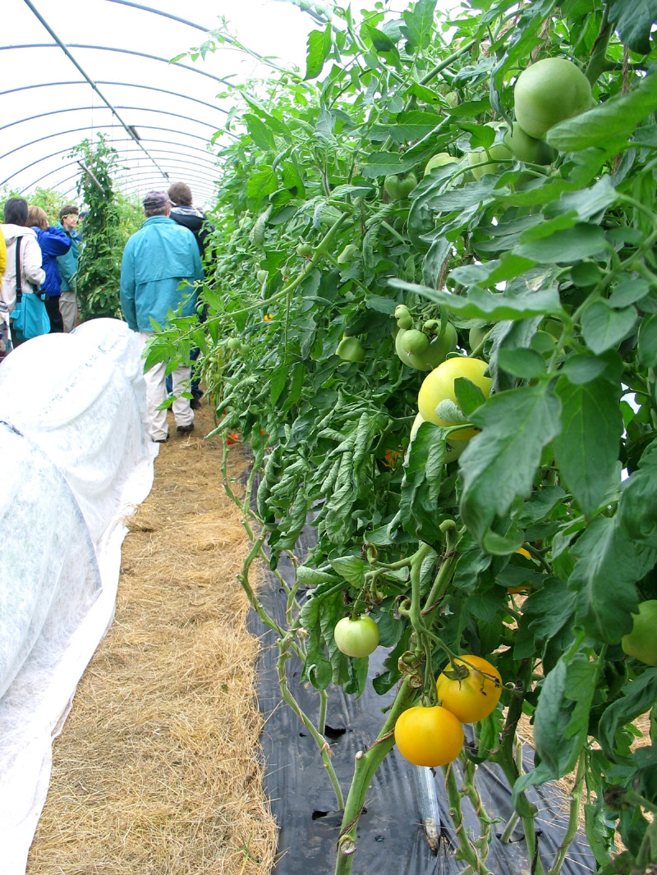
Photosynthesis
Reactants
Products
6CO₂ + 6H₂O —» 6O₂ + C₆H₁₂O₆
Carbon + Water —» Oxygen + Sugar
dioxide
Source: www.nrcs.usda.gov/wps/portal/nrcs/detail/wi/home/?cid=nrcs144p2_027331
Source: www.nasa.gov/topics/earth/features/nitrogen_ozonestress_prt.htm
Notes:
-This is the equation for photosynthesis.
-Carbon dioxide and water are on the left side of the arrow. [Click mouse or use enter key to advance slide for animation.]
-These are the reactants of the chemical reaction. [Click mouse or use enter key to advance slide for animation.]
-Plants must obtain carbon dioxide and water from the environment to conduct photosynthesis. Remember, plants take up water through their roots and carbon dioxide through the stomata. When a stoma is open, however, water is released to the atmosphere during transpiration.
-Without sufficient carbon dioxide or water, plants are not able to photosynthesize.
-Oxygen and a sugar, called glucose, are on the right side of the arrow. [Click mouse or use enter key to advance slide for animation.]
-These are the products of the chemical reaction. [Click mouse or use enter key to advance slide for animation.]
-Most of the oxygen a plant produces is released through the stomata, and the sugar is used by the plant for energy or to build other carbohydrates to make structures, such as leaves, stems, and fruit.

Slide 16
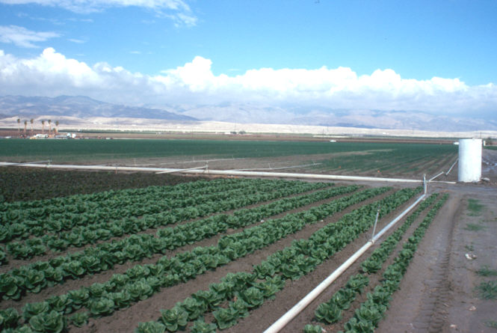
Shade as an Adaptation
What are some of the challenges of using shade structures?
Source: www.nrcs.usda.gov/wps/portal/nrcs/detailfull/national/water/quality/tr/?cid=nrcs143_010914
Notes:
-This is a photo of lettuce growing in California.
-Can you think of some of the challenges of using shade structures on these agricultural fields? [Answer: these fields are very large, so constructing shade structures over them would be very costly and require a great deal of labor, materials, and time.]
-Now answer question 7 on page 4 of your handout.

